Slide 1
Prediction of Credit Card Acceptance
Team Members:
Joydeep Das
Jhumpa Das
Puja Mandol
Sk Injamamul Haque
Soumen Mahata
Md Rabiul Islam
Project Mentor:
Prof. Arnab Chakroborty

Slide 2
Contents
What is Machine Learning?
Why Mach ine Learning?
Workflow
Project
Project Objectives
Analysis Through Graph
Future Scopes
Conclusion
Bibliography

Slide 3
What is Machine Learning
Machine Learning is the scientific study of algorithms
and statistical models that computer systems use in
order to perform specific tasks effectively relying on patterns and interference instead. The name Machine Learning was coined in 1959 by Aurthur Samuel.

Slide 4
Why Machine Learning
Automatically adapt and customize to individual users.
Discover new knowledge from huge amount of data.
Perform repetitive monotonous tasks of humans which require intelligence and experience.
No human experts.
Rapidly changing phenomenon.

Slide 5
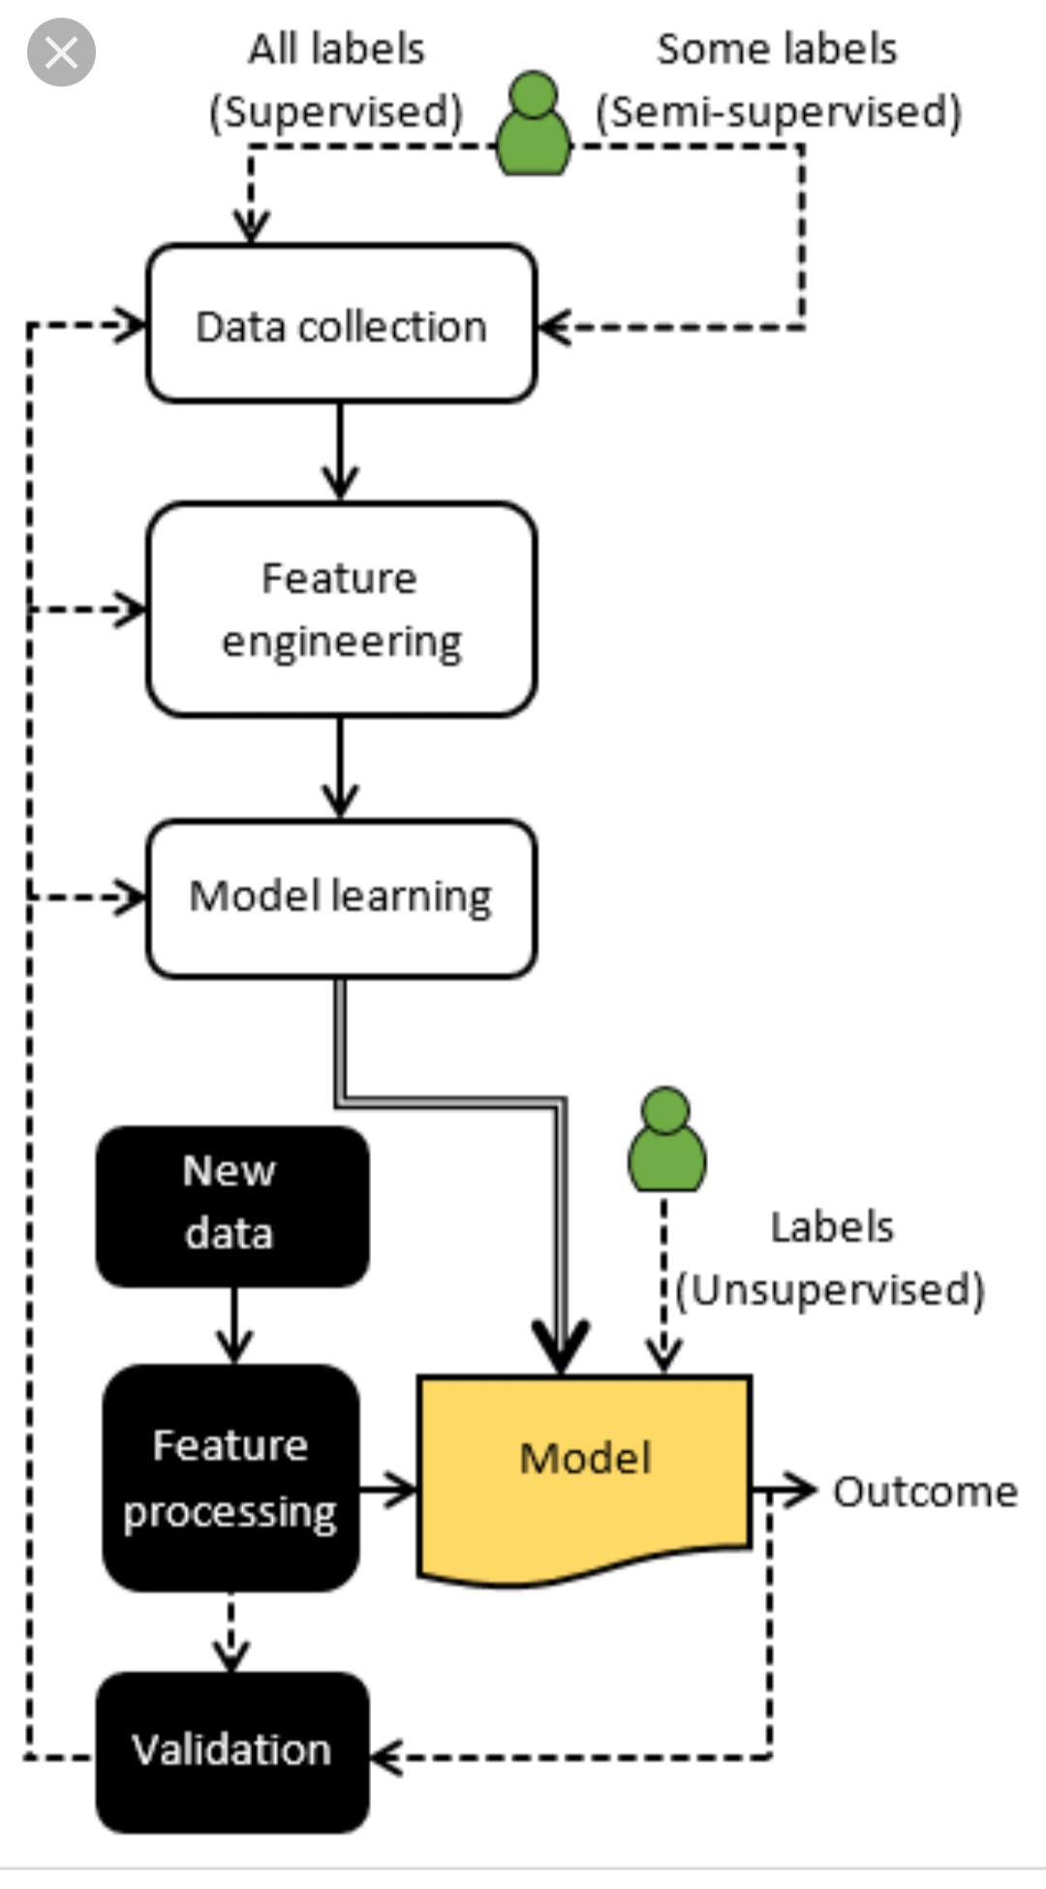
Workflow

Slide 6
Data Analysis of Credit Card Acceptance
Factors of Credit Card Acceptance
Reports
Expenditure
Salary
Age
Income
Share
Owner
Self Employed
Dependants
Months

Slide 7
Objective
Main objective of this project is to predict whether credit card should be given to a person or not by using some Machine Learning algorithms. We also have showed the dependencies among various attributes using different graphs such as heat plot, bar graph, histogram etc.

Slide 8
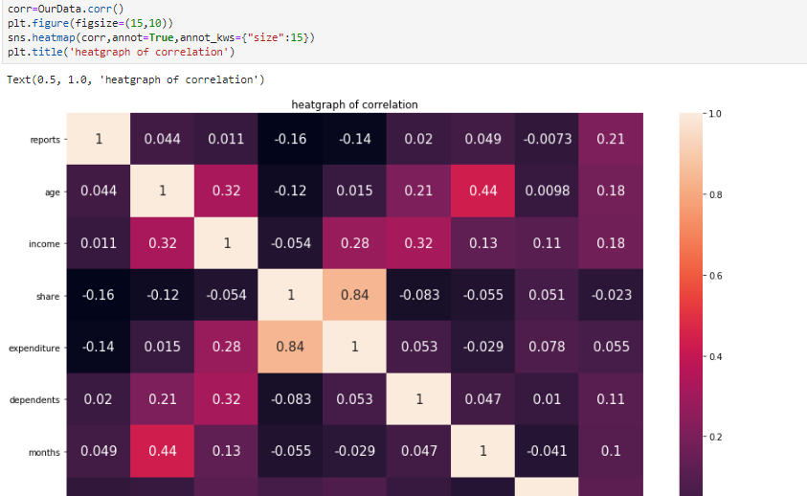
Analysis Through Graphs: This graph shows the correlation among data. Range=-1 to 1.Nearly +1 denotes highly positive correlation and nearly -1 denotes negative correlation. 0 means no relation.

Slide 9
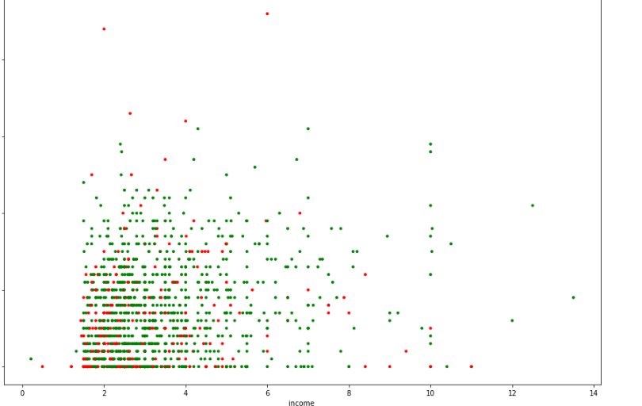
This is a scatter plot of Income v/s active and non active credit cards

Slide 10

Now we have a data sample which can be considered for modelling. We are splitting the data sample into test sample and train sample
Using KNN algorithm we can predict the optimal number for K-nearest neighbours . Decision tree shows the paths of the output. Thus they can predict the result.

Slide 11
Future Scope of Machine Learning
It involves the development of autonomous computers, software programs face reorganizations and other automated tasks.
In future users will receive more precise recommendation and ads will become both more effective and less annoying.
It can reduce the human tasks and give birth to new technology.

Slide 12
Conclusion
What are the uses of Machine Learning.
Different types of graphical representation.
How different types of algorithms predict the result.
Overview of the whole process.

Slide 13
Bibliography
https://bing.com/images
https://en.wikipedia.org
www.edubilla.com
https://www.dezyre.com

Slide 14
Thank You

